Slide 1
Protein-Protein Network Analysis
Mapping Disease Pathways
An Example: Pathway Discovery in Rheumatoid Arthritis (RA)
Team 7 & AIE-C
Team Members:
• G Prajwal Priyadarshan (CB.SC.U4AIE24214)
• Kabilan K (CB.SC.U4AIE24224)
• Kishore B (CB.SC.U4AIE24227)
• Rahul L S (CB.SC.U4AIE24248)

Slide 2
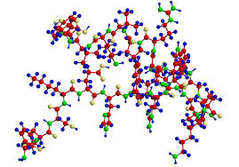
Chapter 1: Foundations
What Are Protein-Protein Interactions (PPIs)?
Protein-Protein Interactions are the physical contacts between two or more proteins that are necessary to carry out a specific biological function.
Fundamental to Life
PPIs drive virtually all cellular processes, from DNA replication to signal transduction.
Dysfunction = Disease
When these interactions go awry, they often lead directly to pathological conditions, including cancer and autoimmune diseases.

Slide 3
From PPIs to Networks
Proteins (Nodes)
Each individual protein within the cellular system.
Interactions (Edges)
Pathways (Structure)
The physical or functional relationships between proteins.
The resulting network structure represents entire signaling pathways and processes.
A PPI network is essentially a map that helps us visualize and understand the complex cellular machinery, providing a holistic view of function.

Slide 4
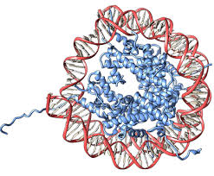
Chapter 2: Methodology
Constructing the Network: Data Generation
Experimental Methods
Direct techniques used in the lab to confirm interactions:
Yeast Two-Hybrid (Y2H)
Co-Immunoprecipitation (Co-IP)
Computational Databases
Integrating published literature, high-throughput data, and predicted interactions:
STRING Database (Used in our RA example)
BioGRID, IntAct
The STRING database aggregates known and predicted PPIs, offering a high-confidence network foundation for analysis.

Slide 5



Network Topology Basics: The Importance of Hubs
Nodes (Proteins)
Edges (Interactions)
The individual points in the network. Their identity determines the function.
The connections between nodes. The 'wiring' of the cellular circuit.
Why Hubs Matter: High-degree hub proteins are crucial for network stability. Targeting a hub can often disrupt an entire disease pathway.
Degree/Centrality
The number of connections a node has. High-degree nodes are called Hubs.

Slide 6
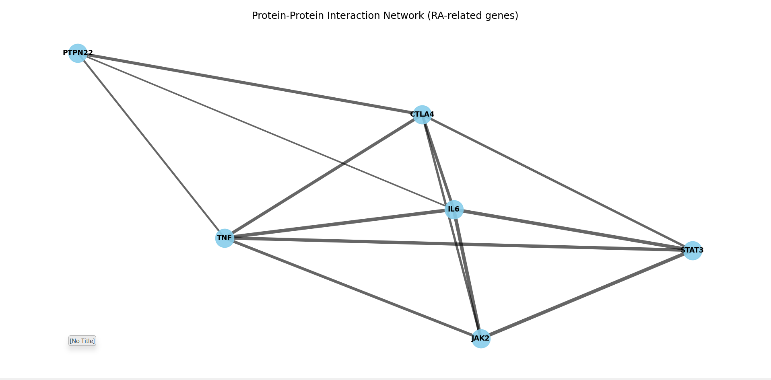

Slide 7

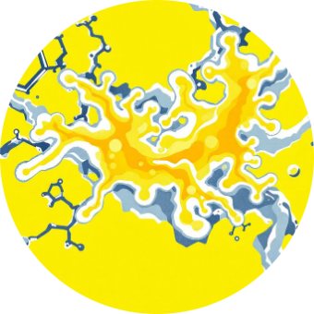
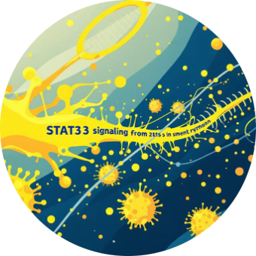
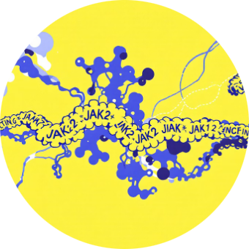

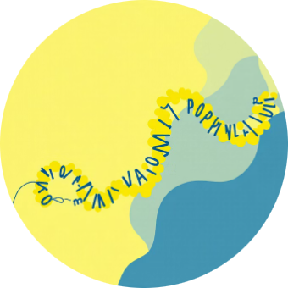
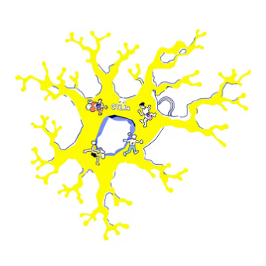

Chapter 3: Case Study
The Rheumatoid Arthritis (RA) Pathway
We constructed a network using six key proteins associated with RA pathogenesis, as visualized by the Q2.py script.
Janus Kinase 2
Janus Kinase 2
TNF - Tumor Necrosis Factor
IL6 - Interleukin 6
STAT3-
JAK2 -
Cytotoxic T-Lymphocyte-Associated protein 4
PTPN22
CTLA4

Slide 8

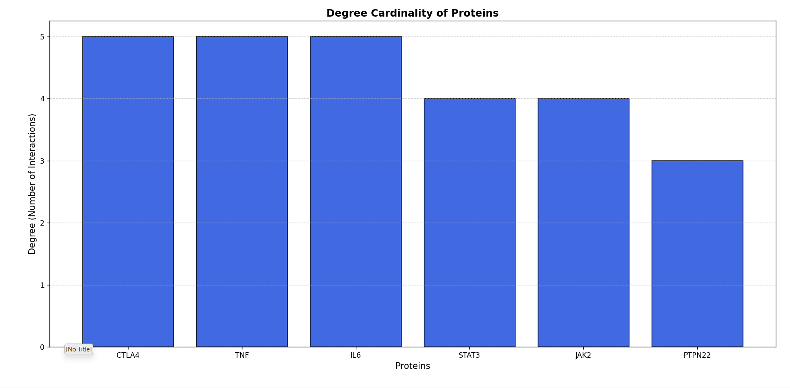
Analysis: Identifying the Top Hubs
By calculating the Degree Centrality for each node, we quantitatively rank the influence of each protein in the RA network.
The centrality output from the analysis reveals that two key inflammatory cytokines stand out:
TNF (Tumor Necrosis Factor)
A master regulator of inflammation; a highly connected node, driving many downstream effects.
IL6 (Interleukin 6)
Another major pro-inflammatory cytokine with high connectivity, essential for immune response regulation.
High degree centrality indicates significant influence within the disease pathway.

Slide 9
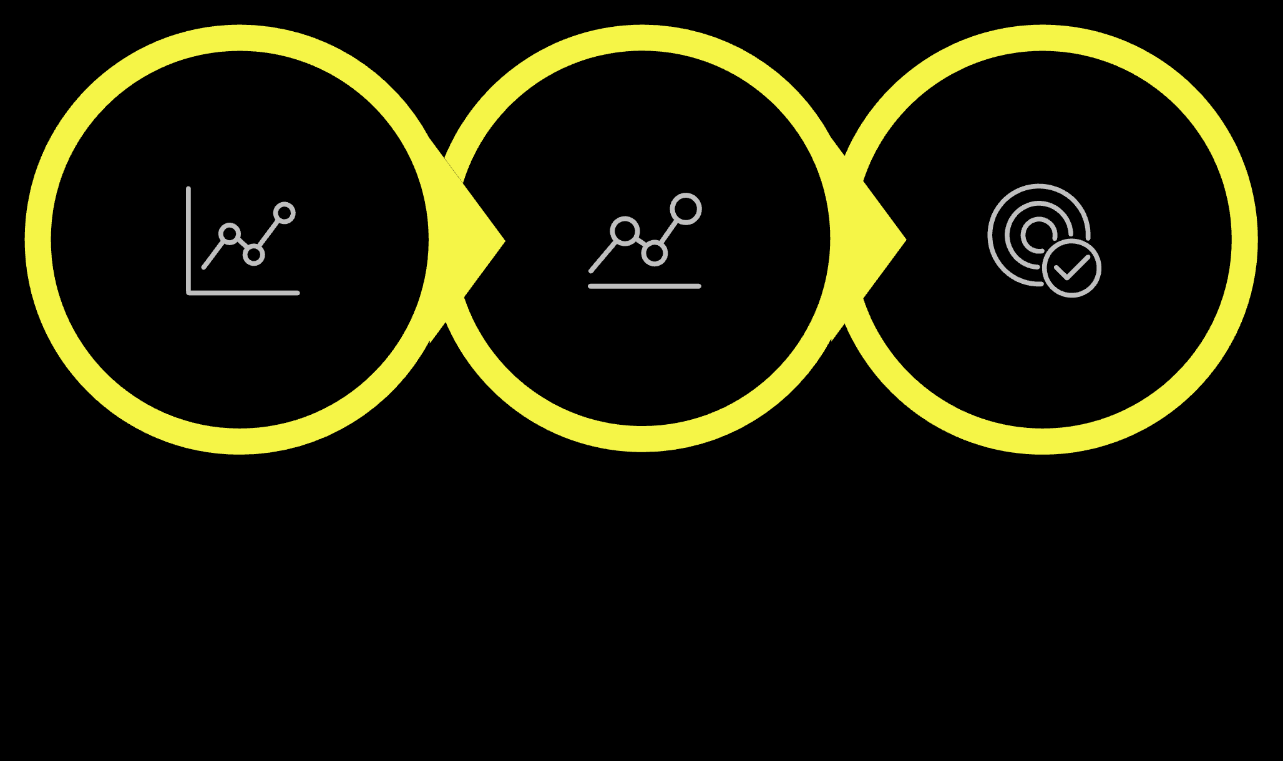


Chapter 4: Integration
Linking Networks to Gene Expression Data
Diff. Gene Expression
Central Hub ID
PPI Network
Network analysis complements Differential Expression Analysis (Q1.py) by providing crucial context:
A gene may be highly upregulated, but only network analysis can confirm if that gene is a central player (a hub) or merely a peripheral component.
We can prioritize therapeutic targets by selecting highly connected genes that also show significant changes in expression during the disease state.

Slide 10



Key Applications in Biomedicine
PPI network analysis is a cornerstone of modern systems biology, offering deep insights into disease architecture.
Identifying Drug Targets
Hubs like TNF and IL6 are often excellent drug targets because their inhibition disrupts the entire pathological process.
Understanding Mechanisms
It reveals novel relationships and pathways, helping researchers move beyond single-gene studies to holistic understanding.
Biomarker Discovery
Connected clusters of proteins can serve as panels for early disease detection and prognosis monitoring.

Slide 11
The Power of Connection
Summary: Why Network Analysis is Essential
PPI Networks move us from looking at individual components to seeing the entire system.
Topology metrics like Degree Centrality quantitatively rank the most influential proteins (Hubs) in a disease pathway.
Integrating networks with gene expression data allows for the prioritization of biologically and strategically relevant therapeutic targets, such as TNF and IL6 in Rheumatoid Arthritis.

